Slide 1





Seo Keyword Generator
by analysing video

Slide 2

Problem Statement
The project aims to develop a tool/web application that assists content creators in optimizing their videos for SEO rankings. The tool will:
Extract text from already existing videos.
Analyze the extracted data to understand key topics and relevant information.
Generate AI-driven SEO-optimized descriptions, including relevant keywords, hashtags, and links.
Provide keyword and hashtag suggestions for platforms like YouTube, helping users improve their content's visibility and SEO rankings.
The ultimate goal is to create a tool similar to vidiQ, offering creators insights and suggestions to enhance their video content's SEO performance.

Slide 3



Business Case
Problem Overview
Solution
Market Opportunity
Many content creators face difficulties in selecting relevant keywords and hashtags that enhance their content's visibility on digital platforms like YouTube, Instagram, and TikTok.
Our tool simplifies this process by using AI to analyze video/audio content and generate SEO-optimized keywords and descriptions automatically. This saves time and improves content discoverability.
The growing number of creators and marketers in the digital space demands efficient tools to enhance SEO. This tool addresses the increasing need for keyword optimization and is scalable to meet future market demand.

Slide 4


Basic Understanding
Project Scope
The project aims to develop an AI-driven SEO keyword generator for content creators, particularly for video and audio content. The tool will assist in generating SEO-optimized keywords, hashtags, and descriptions to improve search engine visibility and content discoverability.
Key Features
User authentication (Login/Signup, free and premium plans)
Content upload (video, audio, text)
AI-generated SEO suggestions based on content
Keyword and description suggestions for platforms like YouTube, Instagram

Slide 5
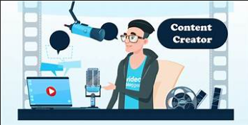
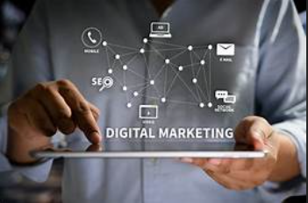

Who Are The Typical Users?
Content Creators
Digital Marketers
Small Business Owners
YouTubers, bloggers, influencers, and podcasters who need to optimize their content for better visibility.
Marketing professionals who manage campaigns for businesses and need to optimize content for organic reach.
Entrepreneurs who create content to promote their brand and require efficient SEO strategies to enhance their online presence.

Slide 6






How Does Solution Help Users?
AI-driven keywords and hashtags improve the content’s SEO ranking, boosting its discoverability across platforms like YouTube and Instagram.
SEO Optimization
The tool automates the process of keyword research, saving creators and marketers hours of manual work.
Time Efficiency
AI identifies trending and relevant keywords, enabling creators to optimize their content for higher traffic and engagement.
Content Visibility

Slide 7



Key Benefits To Business
SubscriptionRevenue
Competitive Edge
User Growth
Monetization through premium subscriptions for advanced features and priority support.
As the need for SEO optimization grows in the content creation industry, this tool can rapidly expand its user base.
AI-powered SEO optimization for video and audio content is a unique offering that provides a competitive advantage over text-based SEO tools.

Slide 8



Selling Point
Limited number of content uploads (e.g., 3 per day)
Basic keyword suggestions and hashtags
Ads displayed in the user interface
Unlimited uploads and access to advanced keyword suggestions
Ad-free experience
Access to priority customer support
Analytics and performance insights for keywords

